Slide 1
CS 4530: Fundamentals of Software Engineering Lesson 6.2 Introduction to React
Jonathan Bell, Adeel Bhutta, Ferdinand Vesely, Mitch Wand
Khoury College of Computer Sciences
© 2022 Released under the CC BY-SA license

Slide 2
Learning Goals
By the end of this lesson, you should…
Be able to explain how component reuse simplifies application development
Understand how the React framework binds data (and changes to it) to a UI
Notes:
By the end of this lesson, you should be able to explain how component reuse simplifies application development.
And you should understand how the React framework binds data, and changes to the data to the user interface, making the development of interactive web applications easier.

Slide 3
HTML: The Markup Language of the Web
Language for describing structure of a document
Denotes hierarchy of elements
What might be elements in this document?
Notes:
HTML is the markup language of the Web.
It is a language for describing the structure of a document.
And it does so by denoting the hierarchy of elements in the document.
On the right, we see an article from a newspaper and an electronic version of it.
We can see that the article has a title, a subtitle, an image, and multiple paragraphs in it.
These are all elements that can be found in html.

Slide 4
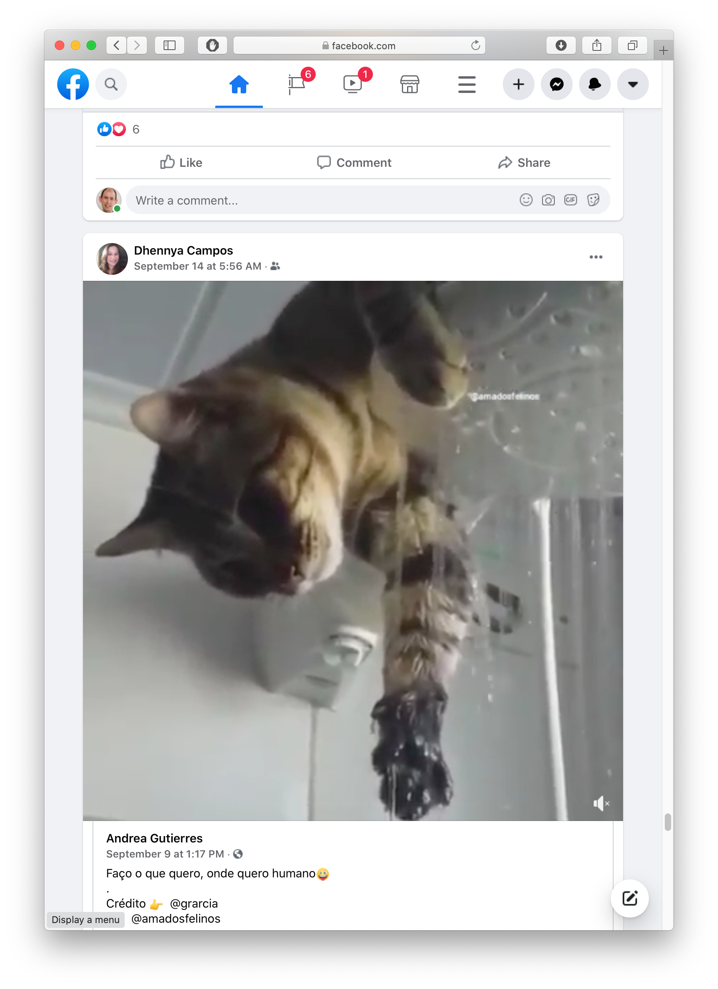
Rich, interactive web apps
Infinite scrolling of cats
Notes:
HTML only gives us only static web apps.
In order to build more complicated logic and add interactivity, we need to add JavaScript.
If we want to add much more complicated features a such as infinitely scrolling cats where the page automatically loads more data as we scroll, we would want something more than just JavaScript.
We need something which brings repeatability and structure to JavaScript, which will make development easy.
One framework for doing just that, is React, which we will look at in the further slides.

Slide 5
Typical properties of web app Uis Building abstractions for web app development?
Each widget has both visual presentation & logic
e.g., clicking on like button executes some logic related to the containing widget
Logic and presentation of individual widget strongly related, loosely related to other widgets
Some widgets occur more than once
e.g., comment/like widgets
Changes to data should cause changes to widget
e.g., new images, new comments should show up in real time
Notes:
Before jumping straight into React, let us understand some of the typical properties of web application Uis,
And how we build abstractions for web application development?
Interactive web apps are made up of widgets. A widget is an element with which a user interacts.
It has visual representation, as well as logic.
For example, Clicking on a like button executes some logic related to it.
Logic and presentation of a widget are strongly coupled, but different widgets are loosely related.
A widget might appear multiple times on a single page, such as the like and comment widget for each image.
And any changes to the data should update the widget.
Such as new images or comments showing up in real time.
But how do we build such widgets?

Slide 6
Key Idea: Components
Web pages are complex, with lots of logic and presentation
How can we organize web page to maximize modularity?
Solution: Components - Easy to repeat, cohesive pieces of code (hopefully with low coupling)
Notes:
The key idea here is to use component-oriented design.
In order to organize the web page and maximize modularity, the recommended approach is to use components.
Components are easy to repeat, cohesive pieces of code, which are loosely coupled to each other.
Some examples of components that we see here are the post itself, the like/share/comment buttons, and the comments.

Slide 7
Components
Organize related logic and presentation into a single unit
Includes necessary state and the logic for updating this state
Includes presentation for rendering this state into HTML
Synchronizes state and visual presentation
Whenever state changes, HTML should be rendered again
Notes:
Components organize the logic and presentation into a single unit.
This includes the state, and the logic necessary to update the state.
And it also includes the presentation for rendering this state.
Components also synchronize the state with it’s presentation.
Meaning, whenever the state changes, this updated html is rendered to the screen.

Slide 8
Components Example: Like button component
What does the button keep track of?
Is it liked or not
What post this is associated with
What logic does the button have?
When changing like status, send update to server
How does the button look?
Filled in if liked, hollow if not
Notes:
Let's go a little deeper into components and understand the like button component in terms of the data and presentation it needs to manage.
So, what does the like button keep track of?
It tracks whether the post is liked or not,
And it keeps track of what post it is associated with.
What logic does this button have?
When the like status is changed, it sends an update to the server.
And how does it look?
It is filled in if the post is liked and is hollow if not.

Slide 9
Server side vs. client side
Where should template/component be instantiated?
Server-side frameworks: Template instantiated on server
Examples: JSP, ColdFusion, PHP, ASP.NET
Logic executes on server, generating HTML that is served to browser
Front-end framework: Template runs in web browser
Examples: React, Angular, Meteor, Ember, Aurelia, …
Server passes template to browser; browser generates HTML on demand
Notes:
There are a few design choices which need be made when building web applications.
One such choice is where the template or component should be instantiated?
Some frameworks prefer to compile the templates on the server and then send the html to the browser.
Such frameworks include JSP, cold fusion, PHP. This executes logic on the server.
Another approach could be to compile the html in the client’s browser and render the html.
Some frameworks which do this are React, Angular, Ember, and many more.
This executes logic in the browser and has lower latency.

Slide 10
Expressing Logic
Templates/components require combining logic with HTML
Conditionals - only display presentation if some expression is true
Loops - repeat this template once for every item in collection
How should this be expressed?
Embed code in HTML (ColdFusion, JSP, Angular)
Embed HTML in code (React)
Notes:
Another design choice is related to expressing logic?
Templates or components require conditional rendering.
They may display some content only if the condition is true or might require loops to repeat the content.
How should this be expressed?
We can either do this by embedding code in HTML or embedding HTML in code..

Slide 11
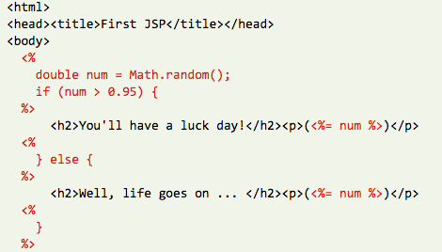
Embedding Code in HTML
Template takes the form of an HTML file, with extensions
Popular for server-side frameworks
Uses another language (e.g., Java, C) or custom language to express logic
Found in frameworks such as PHP, Angular, ColdFusion, ASP (NOT react)
Can’t type check anything
Notes:
When we embed code in html, the template takes the form of an HTML file with extensions.
This is quite popular for server-side rendering frameworks such as PHP, ColdFusion, and JSP.
This typically uses another language to express the logic, such as JAVA or C.
The main drawback is that the logic cannot be statically analyzed, and type checked.

Slide 12
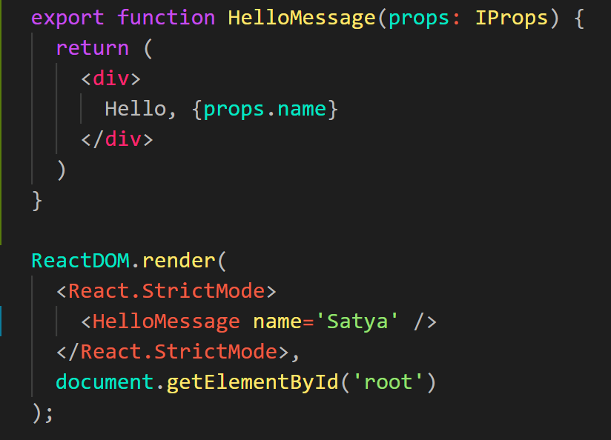
Embedding HTML in TypeScript Aka JSX or TSX
How do you embed HTML in TypeScript and get syntax checking?
Idea: extend the language: JSX, TSX
JavaScript (or TypeScript) language, with additional feature that expressions may be HTML
It’s a new language
Browsers do not natively run JSX (or TypeScript)
We use build tools that compile everything into JavaScript
Notes:
The second approach is the one taken by React, which is embedding html in Typescript/javascript.
But how do we do this?
We extend the language to include the additional features that we want.
This creates a new language called Reactive JS/TS with the extension jsx and tsx respectively.
Since this is a completely new language, the browsers do not run it natively.
We need to use some tools to compile the code to javascript.

Slide 13
React: Front End Framework for Components
Created by Facebook
Powerful abstractions for describing frontend UI components
Official documentation & tutorials: https://reactjs.org/
Key concepts:
Embed HTML in TypeScript
Track application “state”
Automatically and efficiently re-render page in browser based on changes to state
Notes:
And finally, we are going to talk about React!
React is a front end framework for building components.
It was created by Facebook in May of 2013.
It provides powerful abstractions for creating and describing components.
Some of the key concepts that we will cover include:
Embedding HTML in Typescript.
Tracking application state.
And how React automatically and efficiently re-renders parts of the page through a process called reconciliation.

Slide 14
Rich, interactive web apps Infinite scrolling of cats
Built with React
Plus, AirBNB, Uber, Pinterest,
Netflix, Twitter and 8855 more
Notes:
React is and has been among the most popular frameworks for front end development for the past few years.
A lot of applications that we use everyday use React.
Some of these include Facebook, Instagram, AirBNB, Netflix and Twitter.

Slide 15
React Evolution From classes to functional components
Hooks were added to functional components in React 16.8.
Recommended using functional components instead of class components.
Will have more features added.
Neither approach is wrong.
Notes:
Let us talk a little bit about the evolution of react from using class components to functional components.
There are two ways of defining classes in React. It can either be a class or a function.
If you are already familiar with react, you have seen class components such as the one shown on the left.
Starting with React version 16.8, hooks were added to functional components.
The React team recommends using functional components, and we will be using them in this course.
The React team also plans on adding more features to them going forward.
One thing to node is that both the approaches have their own pros and cons, and neither of the approaches is wrong.

Slide 16
Embedding HTML in TypeScript
HTML embedded in TypeScript
HTML can be used as an expression
HTML is checked for correct syntax
Can use { expr } to evaluate an expression and return a value
e.g., { 5 + 2 }, { foo() }
Output of expression is HTML
return <div>Hello {name}</div>;
Notes:
As we know, React uses an extended syntax to include HTML in Typescript.
This allows us to use HTML as an expression in typescript.
An example of this is returning an html element instead of a value or variable.
This allows the html to be checked for correct syntax.
And within this html element, we can add expressions using the curly braces.
For example, writing 5 + 2 in the curly braces would print 7 in the html.
Similarly, calling the function foo() would evaluate the value that foo returns.
We can use this expression to bind data from our component to the html.

Slide 17
Example Component
“Return the following HTML whenever the component is rendered”
“Declare a Hello component”
Declares a new component to which state and other functionality can be added.
The HTML is dynamically generated by the library.
Notes:
This code snippet shows a React component called HelloMessage.
In typescript, a component is declared by defining a function which must start with a capital letter.
Every component must return some html, and in this case, we return “Hello World”.
This component contains no logic or data and is a static component which will return the same html every time.

Slide 18
Properties vs. State
Properties should be immutable.
Created through attributes when component is instantiated.
Should never update within component
Parent may create a new instance of component with new properties
State changes to reflect the current state of the component.
Can (and should) change based on the current internal data of your component.
Notes:
We can customize the behaviour of our HelloMessage component by letting it keep track of some data.
This can be achieved in 2 ways: by using properties, or by using state.
Properties of components are like attributes of html elements.
Every component takes in an optional argument which contains the properties (usually called props).
These should be immutable and should never be updated within the component.
A parent may create a new component with new properties.
In this example, we have modified the HelloMessage component to display the value of an attribute called name.
And this attribute is being set to Satya in the parent component.
States on the other hand, are internal data of the component.
These can and should change during the lifecycle of the component.

Slide 19
Components Example: Like button component
What does the button keep track of?
Is it liked or not (state)
What post this is associated with (property)
Notes:
Going back to the example of the like button component, we can now differentiate between the state and properties.
Whether the post is liked or not is internal to the component and changes throughout the lifecycle.
This is the state of the component.
The post that this component is associated with does not change, and is the property of this component.

Slide 20
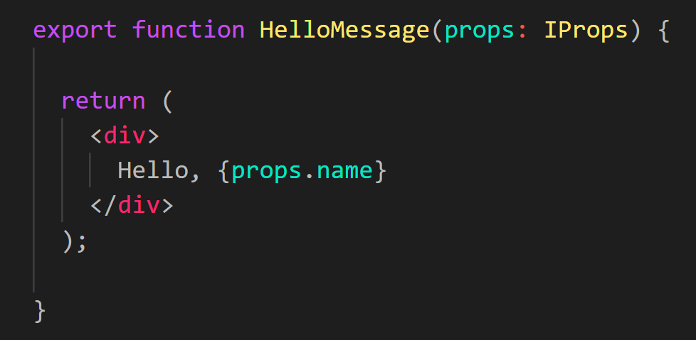
Example Component with Properties
“Set the name property of HelloMessage to Satya”
“Read props.name and output the value”
Components have a props collection that contains a set of properties instantiated for each component.
Evaluates the expression to a value.

Slide 21
What is state?
All internal component data that, when changed, should trigger UI update
Stored as state variables in the component
Created using useState(defaultValue)
E.g. let [state, setState] = useState({});
Only can set directly before a component is created (in useState()). Otherwise must call setState()
Import useState from react
Notes:
Now that we know what properties are, let us see what state is.
State is all internal component data. And when this data is updated, it should trigger an update to the UI.
State is stored as variables in the component.
It is created by calling the useState function().
The use state function returns an array of 2 elements: the first is a state variable, and the second is a setter for that variable.
We can set a default value for the state by passing 1 argument to the useState() function call.
All other updates to state must be made through the setter function.
The useState function needs to be imported from react in the component file.

Slide 22
Reacting to change How does the page update automatically?
Your code updates the state of component when event(s) occur (e.g., user enters data, get data from network)
Updating state causes the html to be re-rendered by the framework (must call setter, not update variable directly)
Reconciliation: Framework diffs the previously rendered DOM with the new DOM, updating only part of DOM that changed
Notes:
So how does react automatically update the html?
When an event occurs in the application, which could be some user interaction like clicking a button, or a network request completing,
Your code updates the state of the component.
This update must occur through the setter, and the state variable should be updated directly.
When the setter is called, the application automatically re-renders the HTML.
The framework compares the previously rendered state with the current state, and only updates part of the UI which have changed.
This is called reconciliation and makes React very efficient. More on this later.

Slide 23
Working with state
useState() should initialize state of object inside component
Use setState to update state (setDate in example)
Doing this will (asynchronously) eventually result in render being invoked
Multiple state updates can be automatically batched together and result in a single render call
Notes:
Let us see an example of using state.
Suppose we want to show the current date in our application.
We can create a new state variable called date, with a setter for it by calling the useState function.
We can pass in the default value as the date object at the time of its creation.
Now, when we want to update the state, we can invoke the setDate function with the new Date.
Doing so will automatically render the html with the updated date.

Slide 24
Nesting components
return (
<div>
<LikeButton post={post} />
<CommentButton post={post} />
</div>
);
Establishes ownership by creating in returned template
Sets post property of child to value of post property of parent
Notes:
Now that we have a working component, we can use this component in other components.
We can create an HTML element with the same name as the function of our component in the HTML of other components.
In this example, we have the LikeButton and CommentButton nested in another component.
The parent component establishes ownership by creating these components in its rendered html.
It can also pass data to the child components by using their props.
Here, the state post of the parent component is passed to the post property of the children.

Slide 25
The data flows down
State that is common to multiple components should be owned by a common ancestor
State can be passed into descendants as properties
When this state can be manipulated by descendants (e.g., a control), change events should invoke a handler on common ancestor
Handler function should be passed to descendants
Notes:
An import thing to note is that the Data flows down i.e from parent component to child component in React.
Thus, state that is common to multiple components should be owned by a common ancestor.
This can be passed to the child components as properties.
When he child components want to update this state, they should invoke a handler on the common ancestor.
The handler function should be passed to the descendants as a prop.
Let us look at an example to understand this better.

Slide 26
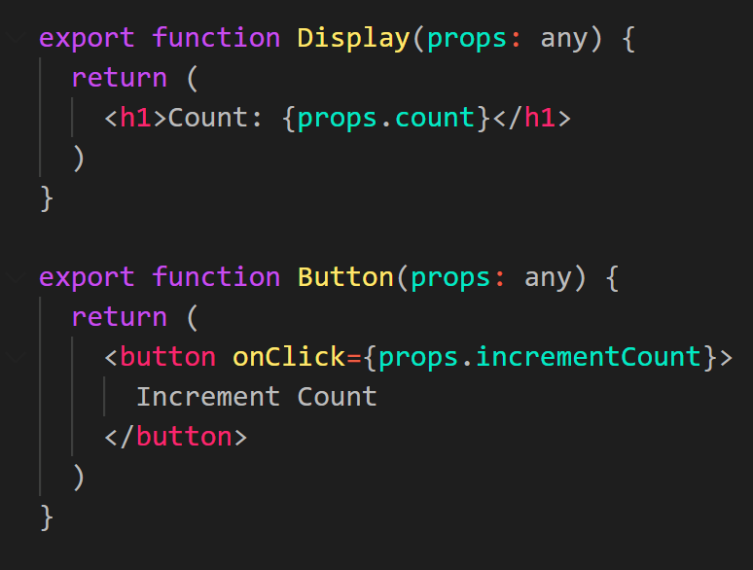
The data flows down
Notes:
Refer to the example of a simple component called counter, which increments the number every time a button is clicked.
This component has 1 state variable called count.
The component has 2 child components, display and button.
When the button component is clicked, it wants to increment count, which will then re-render the display component.
Thus, we declare state on the common ancestor, which is counter.
We create a handler function called increateCount which updates the state variable.
The count is passed as a prop to Display, and incrementCount as a prop to Button.
When the button component is clicked, it invokes the increment count function passed as a prop, which updates the count, which updates the display.
This is how data flow in React works.

Slide 27
Component Lifecycle
Traditionally, the React Component Lifecycle consists of 3 phases
Mounting: When a component first loads
componentDidMount()
Updating: When the component is updated
componentDidUpdate()
Unmounting: When the component is about to be removed
componentWillUnmount()
In functional components, these are replaced by hooks.
Specifically, the useEffect() hook, imported from react
Notes:
Traditionally, React components consist of 3 lifecycle phases.
The first phase is mounting, or when the component first loads.
The second phase is updating, or when the state of the component is updates.
The thirst phase is unmounting, or when the component is about to be removed from the DOM.
Class components consisted of different methods for each phase, but with functional components, there is a single method called use effect.
Use effect needs to be imported from react in the file containing the component.

Slide 28
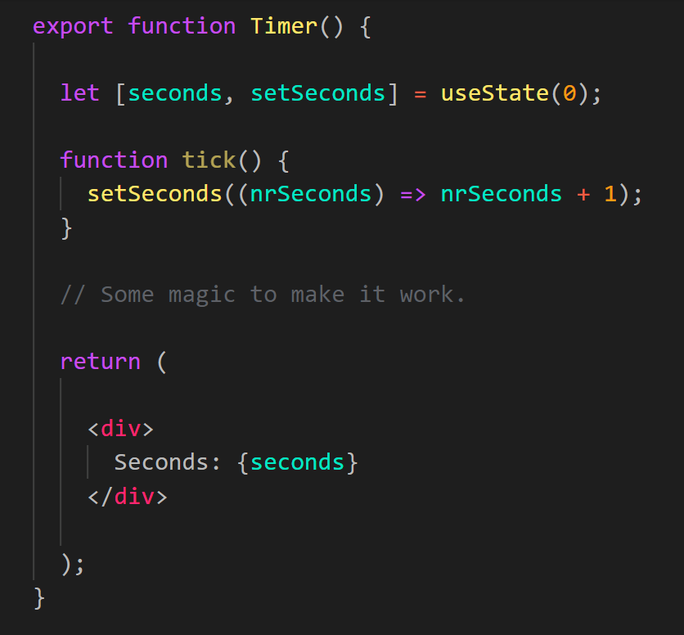
Working with Hooks Self incrementing timer
Notes:
In order to understand the useEffect hook better, consider the example of a simple timer.
We have a state variable called seconds, and the component displays the seconds which have elapsed.
We also have a method called tick to increment the value of seconds.
Now, we need to use the built-in SetInterval method to call the tick function after every second.
Let us see how we can use effects to make that happen.

Slide 29
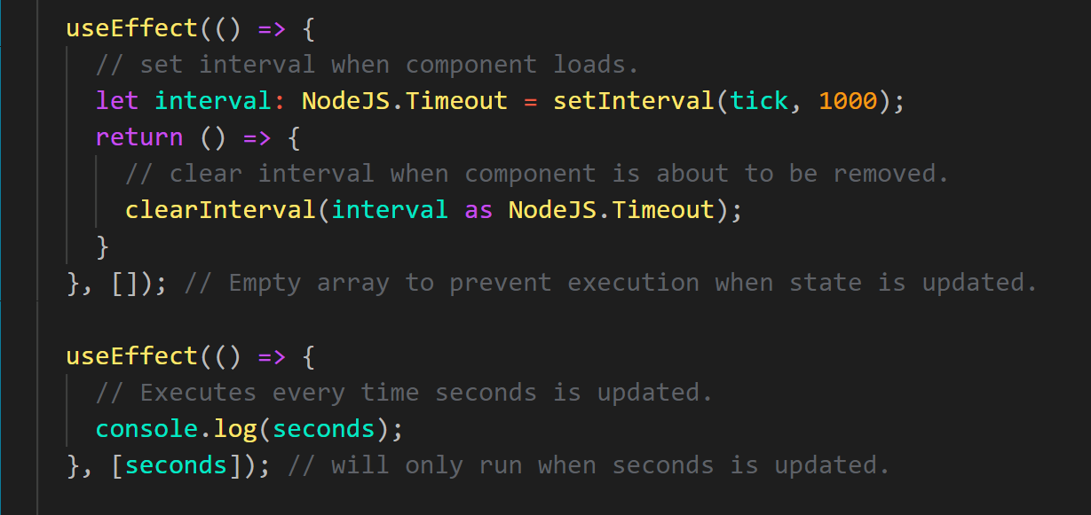
Working with Hooks Self incrementing timer
Notes:
Consider the first call to useEffect. This function takes in 2 arguments, 1st is a function, and second is an array.
Notice that the 2nd argument for use effect is an empty array. This means that it does not depend on any state variables and should execute only when the component is mounted.
We are starting the interval when the component is mounted.
We have another arrow function which is returned by this function.
The function returned will be executed when the component is about to unmount.
This is useful for cleaning up observers and other data to avoid memory leaks.
Now, let us look at the second use effect function. This will run every time the state variable seconds is updated and prints the value to console.
This can be useful to perform tasks unrelated to the UI rendering but dependent on the state variable.

Slide 30
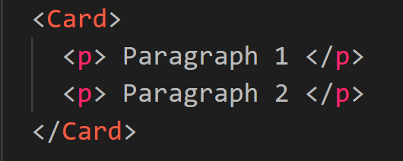
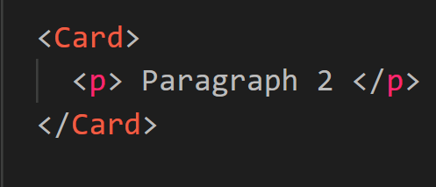
Reconciliation Efficiently updating browser’s view of the app
Process by which React updates the DOM with each new render pass
Occurs based on order of components
Second child of Card is destroyed.
First child of Card has text mutated.
Notes:
As you may recall, Reconciliation is the React’s way of efficiently updating the rendered html.
It is the process by which it updates the DOM with each new render pass.
Consider the case where the card component has 2 child paragraph elements.
Assume that the first paragraph component is destroyed. In order to efficiently update the DOM,
React destroys the second paragraph element, and updates the test of the first element to the text of the second element.
It might appear to the user that the first component was deleted, but in reality, React mutates the first component and deletes the second.

Slide 31
Reconciliation with Keys
Problem: what if children are dynamically generated and have their own state that must be persisted across render passes?
Don’t want children to be randomly transformed into other child with different state
Solution: give children identity using keys
Children with keys will always keep identity, as updates will reorder them or destroy them if gone
Notes:
In many cases, we use loops to render multiple elements which have their own state and props, which should not change across multiple render passes.
Thus, if we have elements in a loop, the index of the array should not be used as a key, since it will be mutated if the length of the array changes.
In order to circumvent this issue, all children should be given a unique ID, not dependent on the list of elements.

Slide 32
Reconciliation with Keys
Notes:
This code snippet shows an example of using an independent array of numbers for assigning keys to the children.
Here, the call to map returns a new array of elements with static IDs between 1 to 5 assigned to each element.
Thus, even if there was a change in the number of children this ID would remain the same.

Slide 33
Next Lecture: Live Coding
TODO: Add screenshot of app we plan to build

Slide 34
Summary - React
Component-based framework
Automatically re-render components based on changes to data
Maps each component to some HTML elements and efficiently updates them
Notes:
To summarize, React is a component-based framework developed by facebook.
It allows us to efficiently manage state and uses reconciliation to efficiently update the DOM.
It maps each component with some HTML and effectively updates them.
In the next lecture, we build a small application from scratch to get some hands-on experience on React.

